Slide 1
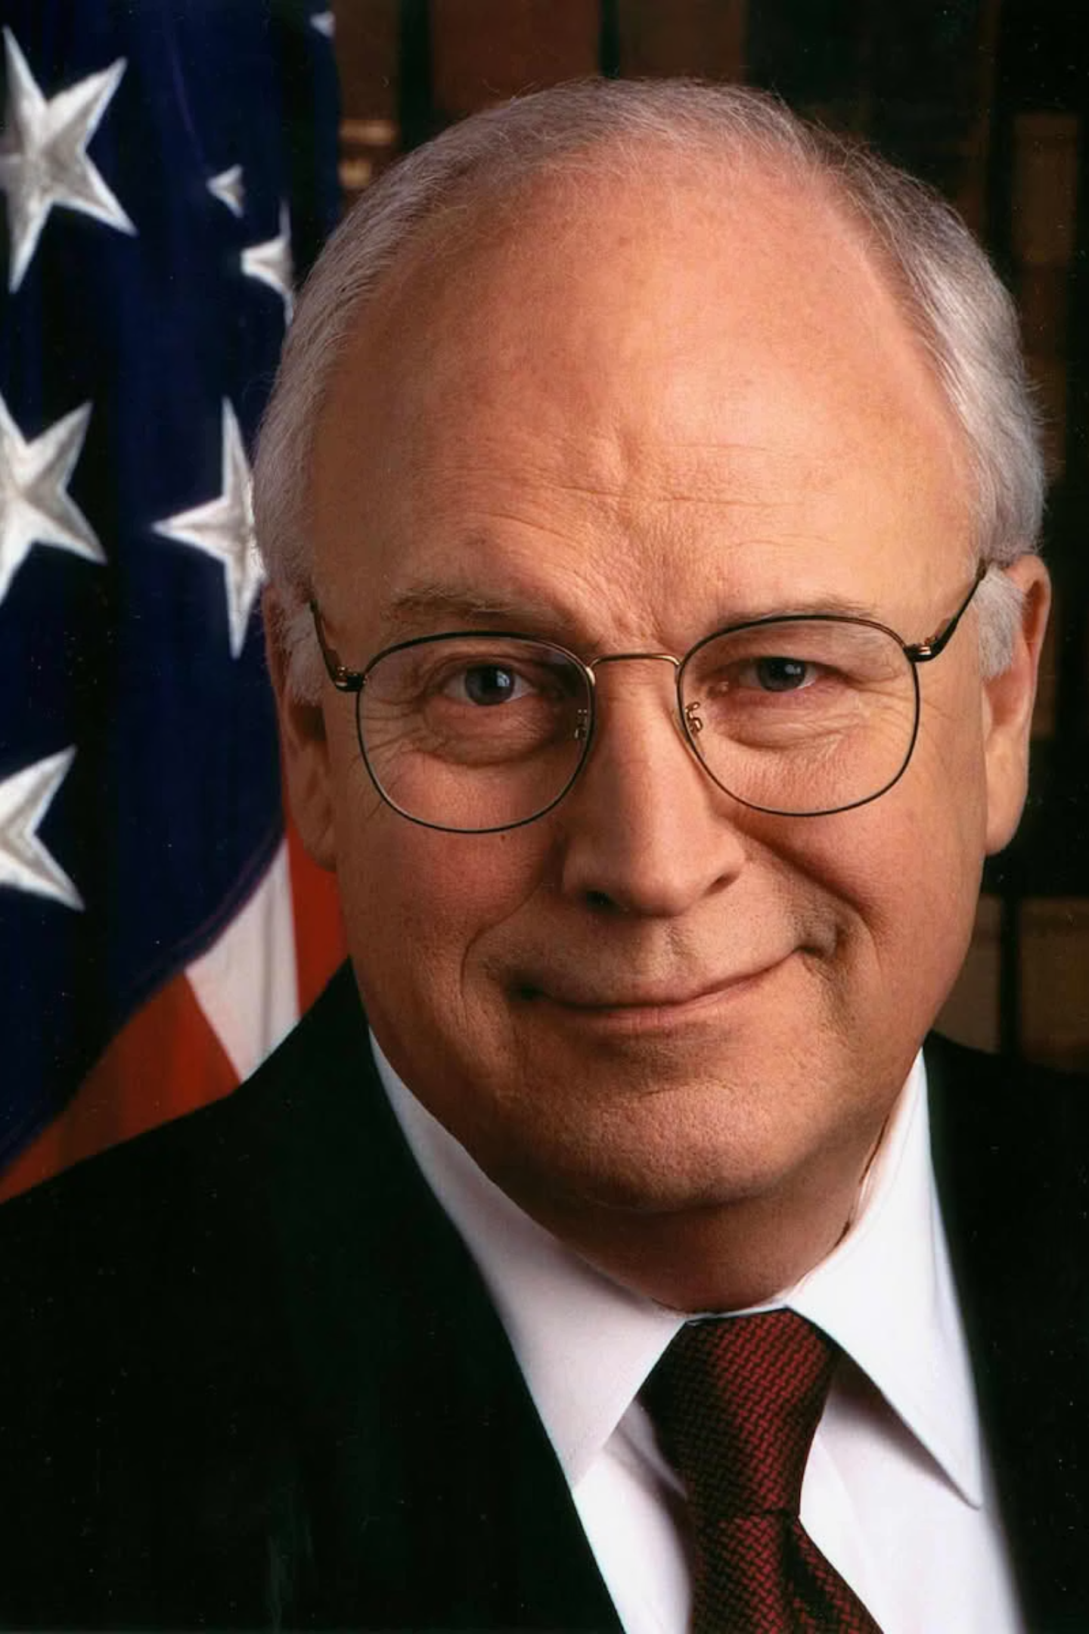
Dick Cheney and the Expansion of Vice Presidential Power
Dick Cheney is one of the most powerful and controversial figures in modern American politics. His specific set of beliefs, often called "Cheneyism," greatly influenced US policy in the early 21st century.
Vaganova Olga
Kurambayev Azamat
Group №: 3834101/30309

Slide 2
Political Career and Evolution
Start of Career
Nixon and Ford administrations
Congressman
Wyoming Representative (1979-1989), Republican Conference Leader
Minister of Defense
Under George H.W. Bush (1989-1993), Operation Desert Storm
Vice President
Under George W. Bush (2001-2009), foreign policy architect
Cheney rose from cautious politician to chief national security strategist, exerting unprecedented influence on the president.

Slide 3

Cheney's Political System: Key Principles
Dick Cheney's political approach was defined by several fundamental principles that shaped his governance philosophy.
Strong Executive Power
Neoconservative Foreign Policy
Energy Policy
Domestic Policy
Cheney strongly believed in the "Unitary Executive" theory. He felt that after the Watergate scandal and the Vietnam War, the power of the president had become unfairly weak. In his view, the president must have maximum freedom in national security matters without too much control from Congress or the courts.

Slide 4
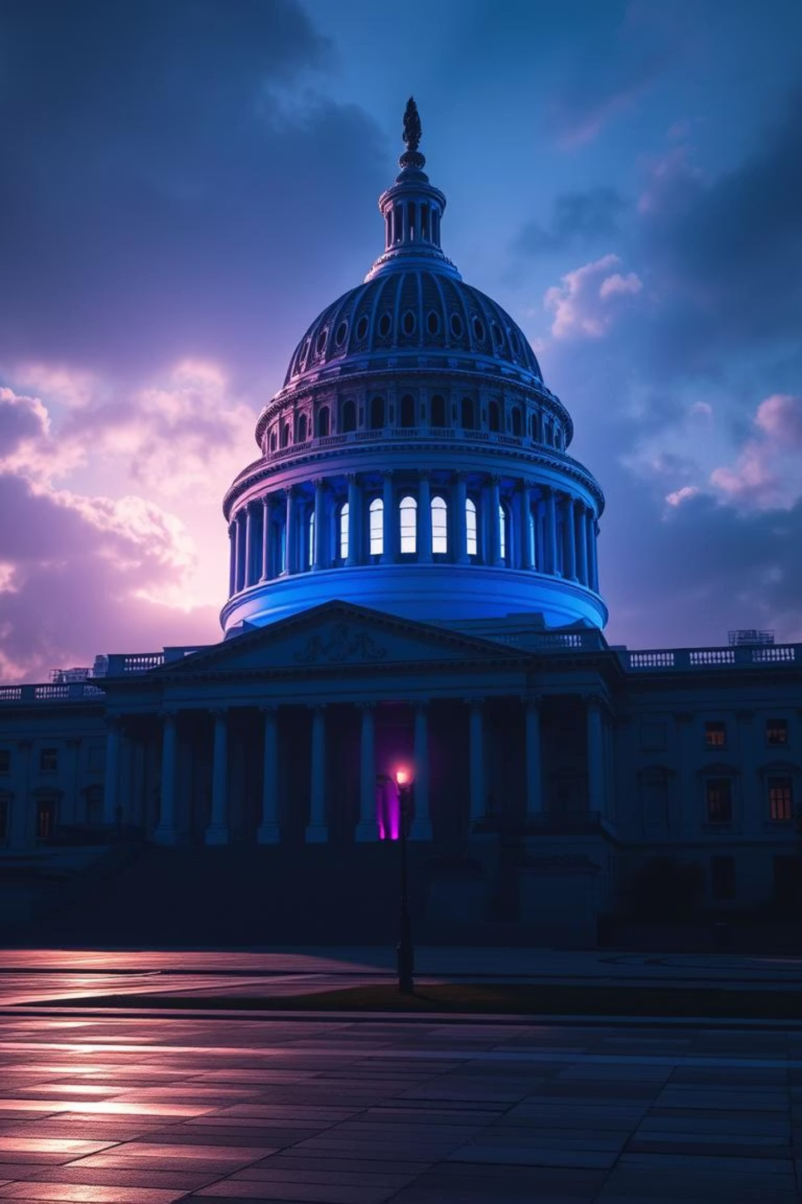
Strong Executive Power
This was evident in:
Secret CIA Prisons
Observation Programs
Creation and use of secret objects
Authorization without court orders
Executive Privilege
Frequently used to deny information to Congress

Slide 5
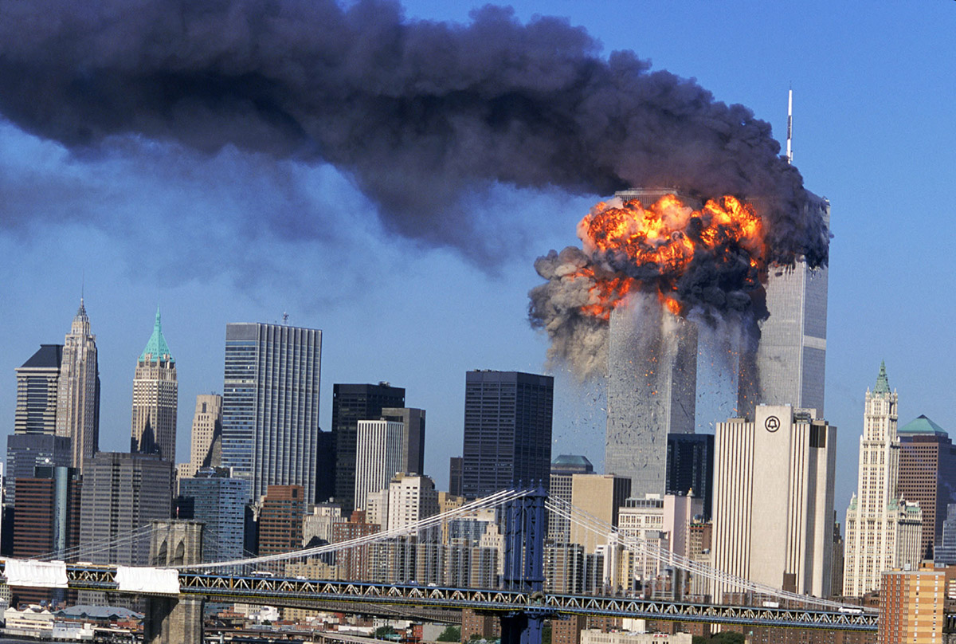

2. Neoconservative Foreign Policy
After the September 11 attacks, Cheney's views hardened.
The Doctrine of Preemptive Strike
The US has the right to attack potential threats before they materialize. This was a main reason for the 2003 invasion of Iraq
Unilateralism
Although the administration looked for support from allies, Cheney was willing to act alone if necessary for US national interests (as with the Iraq war)

Slide 6
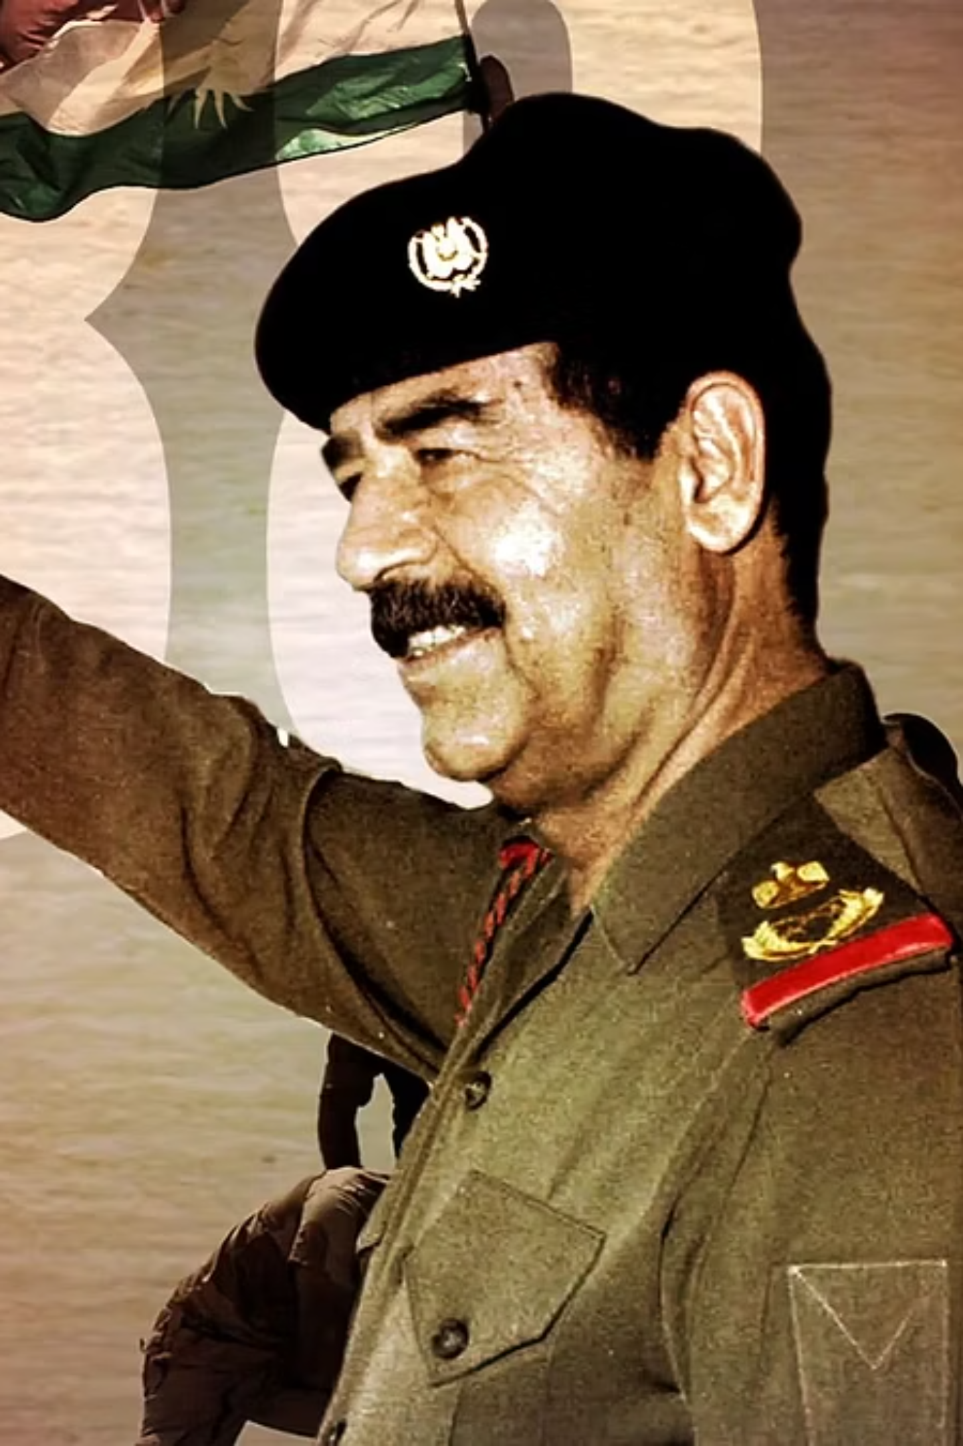
Certainty Over Intelligence Skepticism
He actively supported the idea that Saddam Hussein had weapons of mass destruction (WMD), despite contradictory intelligence reports.

Slide 7

3.Energy Policy Approach
As a former CEO of the oil company Halliburton, Cheney saw energy as a key part of national security. He led the development of the administration's energy policy, which focused on increasing domestic oil and gas production rather than developing alternative energy.

Slide 8

4. Domestic Policy Orientation
On domestic issues, Cheney followed traditional Republican values:
1
Cutting taxes to stimulate the economy
2
Opposing the expansion of government
social programs.
Supporting gun rights
3

Slide 9

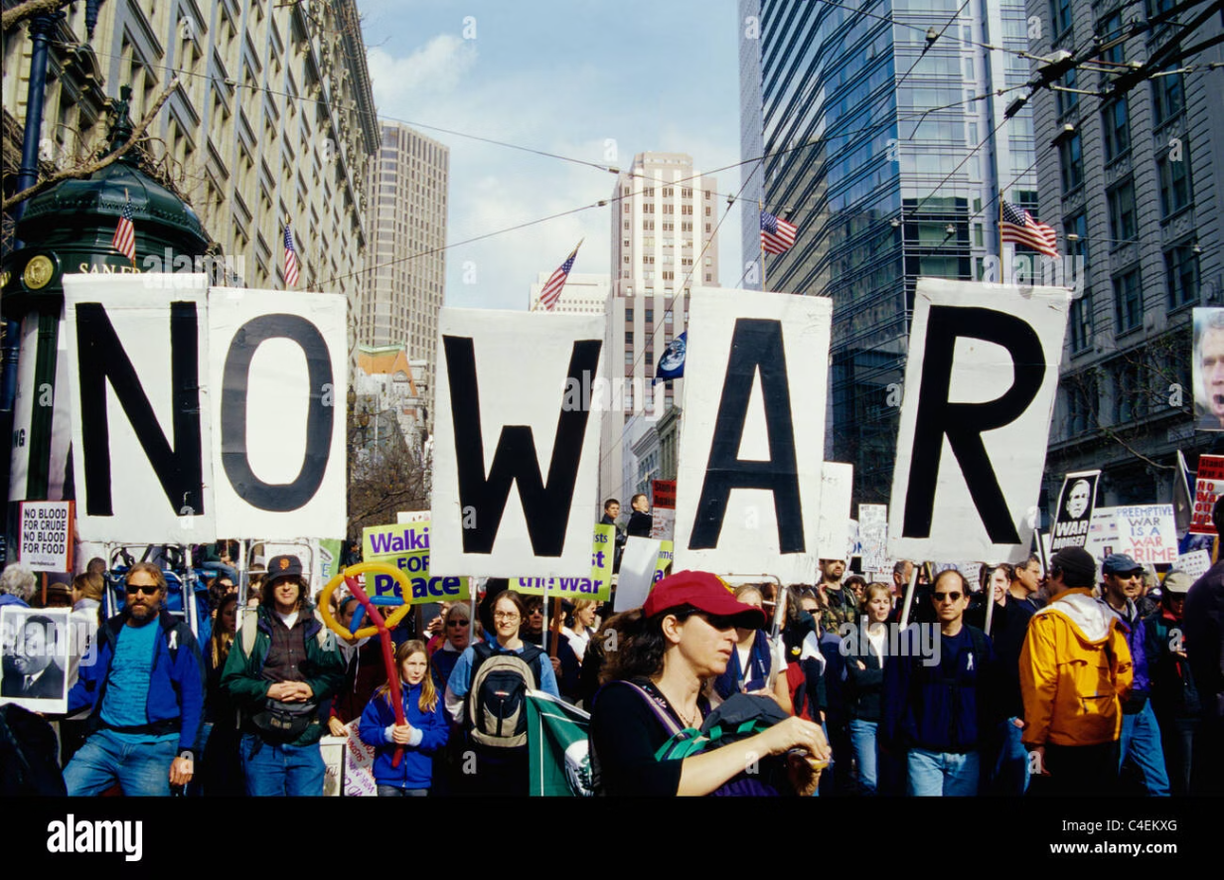
Legacy: Assessment and Controversy
Supporters
Critics
Supporters believe he was a strong leader who made tough decisions to protect America after 9/11 (nine-eleven) and prevent future attacks.
Critics argue that the Iraq War was a mistake, that his methods violated human rights, and that he made the office of the Vice President too powerful.

Slide 10

Conclusion
In summary, Dick Cheney was a highly influential politician. His system, which focused on strong executive authority and an aggressive foreign policy, left a deep and lasting mark on the United States and the world.

Slide 11
Thank you for your attention!

Slide 12
1. What is "Cheneyism" and why is Dick Cheney considered as a controversial figure?
2. What were the main principles of Cheney's domestic policy orientation?
3. According to the text, what was Cheney's stance on the intelligence about Iraq's Weapons of Mass Destruction (WMD)?

